Slide 1
Comparison of Algorithms

Slide 2
Introduction
The transport layer is responsible for facilitating interaction between processes on various hosts.
The network layer, which facilitates data transfer between computers, is essential to the operation of the transport layer.
This can only be achieved by the concerted efforts of all hosts and routers in the network, which is the responsibility of the network layer.
If we had to explain what "Routing" is in layman's words, we can say that it's the process by which we choose the route a segment will take from the sending host to the receiving host.

Slide 3
Common Routing Algorithms:
We apply appropriate algorithms to the graph representations of the networks to determine the shortest pathways
Let there be 'N' nodes in the network, and describe them using the graph G (V, E). Link costs are considered to be positive in all algorithms presented here. Relative to itself, a node incurs no cost.
Further, it is assumed that all linkages are symmetric, such that if di,j = cost of link from node I to node j, then d i,j = d j,i. It is assumed that the whole graph exists.

Slide 4
Project
Project is written in JAVA langauge and we have used some of the assumptions for this project
We also used some random values for heap to compare both the algorithm in terms of effiency.

Slide 5
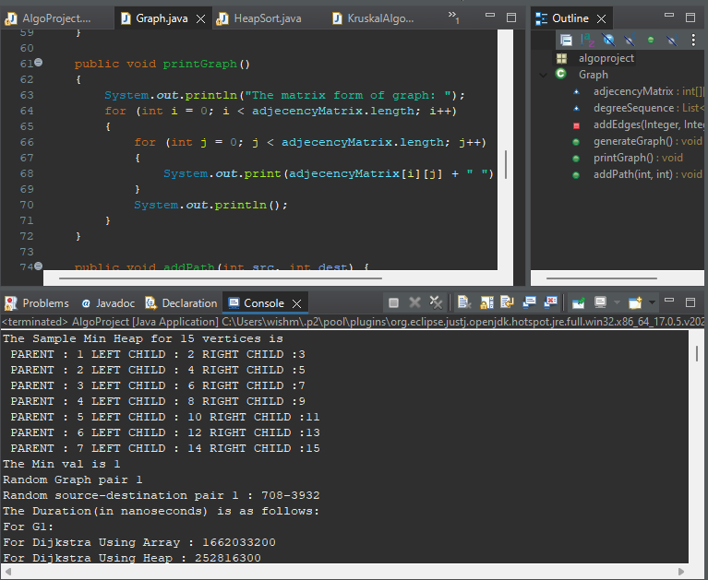
Console Output

Slide 6
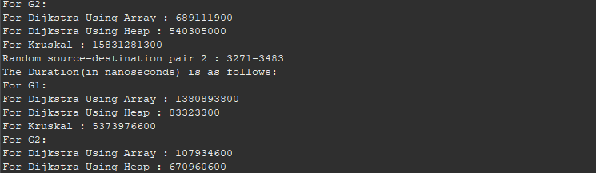
Contt..

Slide 7
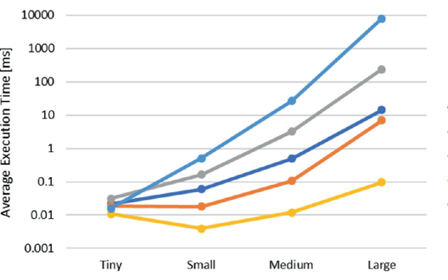
Graphs

